Slide 1
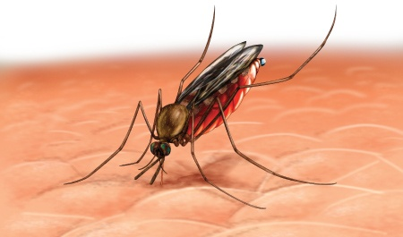
Malaria

Slide 2
Objectives of learning this topic
To understand:
What is malaria?
Cause
Sign and symptom
Treatment
Prevention
At the end of session, participants can plan and conduct Health Awareness Sessions on Malaria to village people

Slide 3
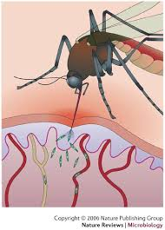
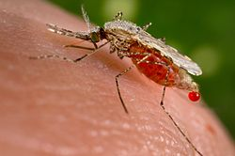
What is Malaria?
Caused by parasites Plasmodium
By Infected female Anopheles mosquitoes
Parasites spread by mosquito bite
Plasmodium
Anopheles mosquito

Slide 4
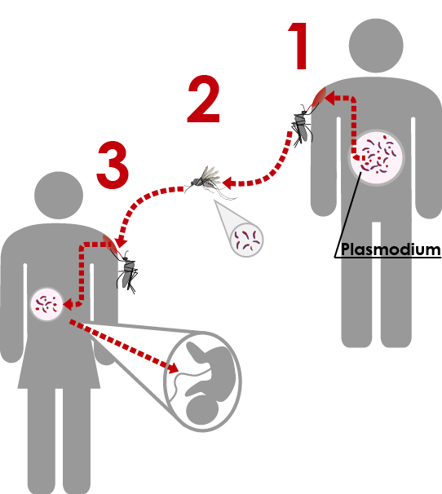
Malaria Transmission
10-14 days
to mature
Female Anopheles mosquitoes
Bite between evening and morning
Anopheles bites and sucks blood
Parasite multiply inside the body of mosquito
Parasites mature after 10-14 days
In pregnant, fetus also might be infected

Slide 5
Malaria in the Liver and Red Blood Cells
Liver Mature and multiply
Red blood cell
Multiply inside
Malaria parasites
Severe Malaria
Normal RBC
Infected RBC
Malaria parasite attack RBC
multiply inside RBC
destroy RBC
Rapid increasing of Infected RBC

Slide 6
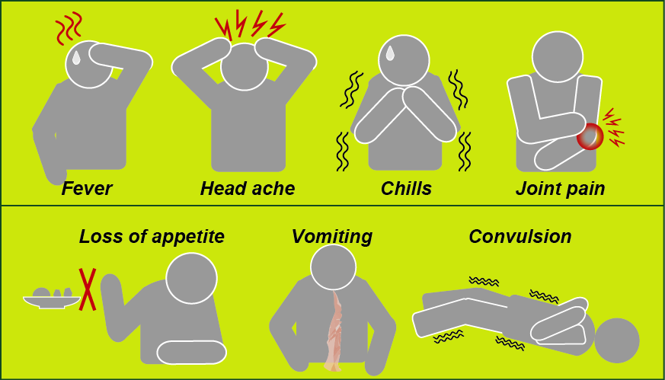
Signs and Symptoms
Symptoms may appear 7 days or more (usually 10–15 days)

Slide 7
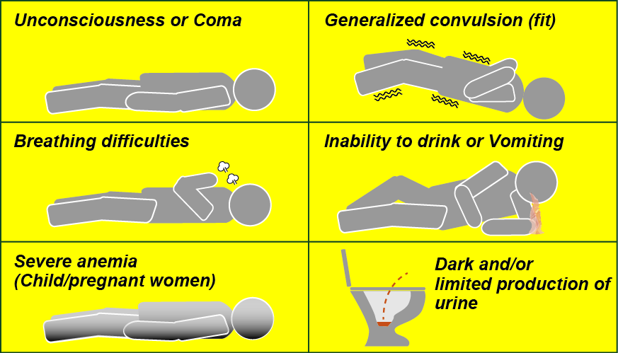
Severe Malaria
Caused by delay in diagnosis and uncomplicated treatment
Malaria in pregnant women is an important cause of stillbirths, infant mortality, abortion and low birth weight

Slide 8
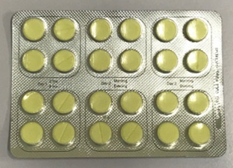
Treatment
Result of microcopy and rapid diagnostic test, before medicine is given by a health care provider
“Coartem” is the common medicine for malaria treatment in Solomon Islands
Take after greasy food or milk for 3 (three) days
Patient must complete all the prescribed medicine even after he/she feels better. Patient must not stop taking medicine by own decision

Slide 9
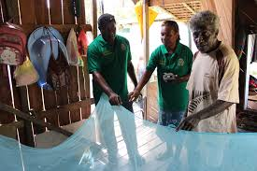
Method of Prevention
Environmental clean-up
Insecticide-treated mosquito nets
Indoor residual spraying
Mosquito screen
Mosquito repellents
Provision of Mosquito net

Slide 10
Environmental clean-up
No water, no mosquito
Maintain drainage
Cut and clear vegetation around the house
Bury tins, cans and bottles
Burn coconut shells and other rubbish
Keep larvae eating fish in pond/pool

Slide 11
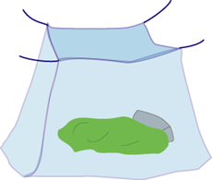
Insecticide-treated mosquito nets
Using long-lasting insecticidal nets (LLINs) at the night time.
Check for hole or tear every time
Make no gap between net and floor
Wash net every six month
Sleep under the net every night

Slide 12
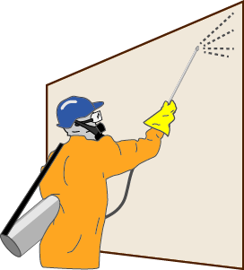
.
Indoor residual spraying (IRS)
Effective way to rapidly reduce malaria
Effective for 3–6 months
Requires well trained and supervised personnel
Conducted by the Vector borne disease control program of the Provincial Health Office.

Slide 13
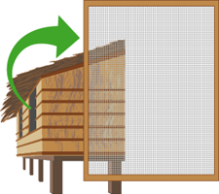
Mosquito screen
Mosquito screen must be fixed on all the windows and doorway without any gap or crack

Slide 14
Mosquito coil
Most common and easy- to-use
Cost is reasonable
Smoke is harmful to infants

Slide 15
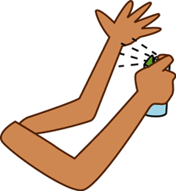
Mosquito repellents
Apply on uncover parts of the skin
Effectiveness continued for 5-8 hours

Slide 16
Long sleeve and trousers

Slide 17
Practice
Practice :
Plan and conduct Health Awareness Session on Malaria control using Flip Charts/ Role play/ Songs/ Presentations etc

